Slide 1
Aaron Riggs, Andre Manz, Chris Baierski, Wesley Scott as
DrinkTank Present
Phil The automated bartender

Slide 2
GUI goals
We want a readable and intuitive design
Need to have a modest use of space for our smaller screen
Connect to and control hardware components seamlessly

Slide 3
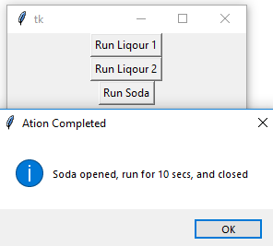
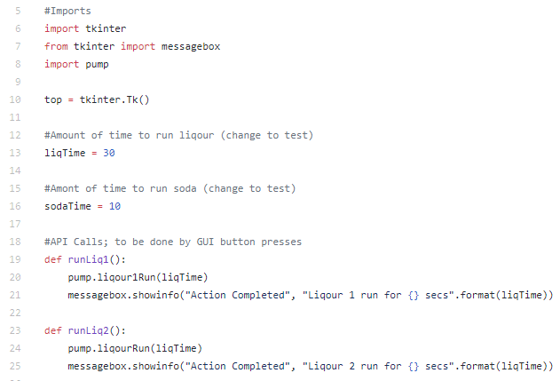
Initial test GUI
Intended to test our initial hardware setup
Easily changeable variables to measure out perfect pours
Proof of concept for our minimum viable product

Slide 4
Future GUI additions (in progress)
Decide on theme, and personalize the widgets
Finalize the design/layout
Add admin area and functionality
Install on the Raspberry Pi

Slide 5
User interviews - the people
4 people spanning about a 10 year age range
All seemed interested in the product, despite some having negative experiences
Most had computer/IT experience, though not all. We don’t believe this would affect any user experiences with PHIL
Notes:
Be sure to mention that all users were assured of their privacy!
Names only shared w/ DrinkTank, Dr. Lim, and Dr. Lim’s Graders
Responses are shared with the class, but only anonymously

Slide 6
User interviews - what we learned
Their biggest collective concern was user adaptability
Not everyone likes their drinks exactly the same way. Customization is key!
Some were concerned about the legality of PHIL (21+ years old)
Because we’re putting the responsibility on bars and party hosts, we don’t have to worry about it
Finally, others wanted to expand PHIL’s uses by adding modules to him later down the line
While this is something we’ve thought about, it is outside the scope of this course. Might be implemented later.

Slide 7
Functional/Non-Functional Requirements
FR
Phil shall be able to dispense all 2 part combinations of mixed drinks from a selection of 2 liquors and 1 soda.
Phil shall have a GUI interface on an LCD screen for user input.
Phil’s GUI shall (this FR will describe features of GUI)
Phil’s companion application shall display its number of drinks dispensed per day and the profit made by the usage of Phil.
NFR
Phil’s companion application shall be accessible at least 99% of the time.
Phil will dispense drinks accurately measured within a 5% margin of error.

Slide 8
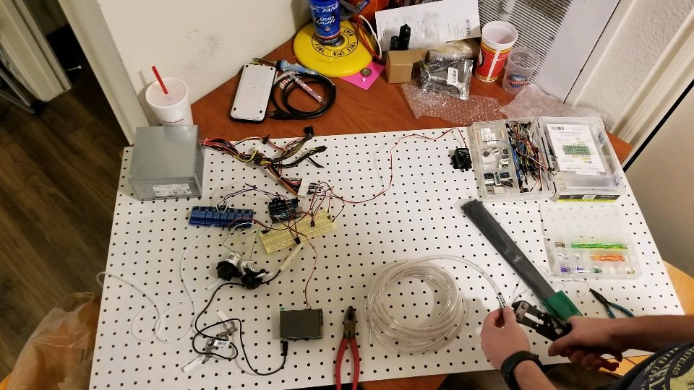
Initial Hardware deployment
Raspberry Pi setup
Perf board used for initial prototype
Dell power supply setup to supply 12v
Initial wiring of relays
Initial wiring of pumps
Zip ties

Slide 9
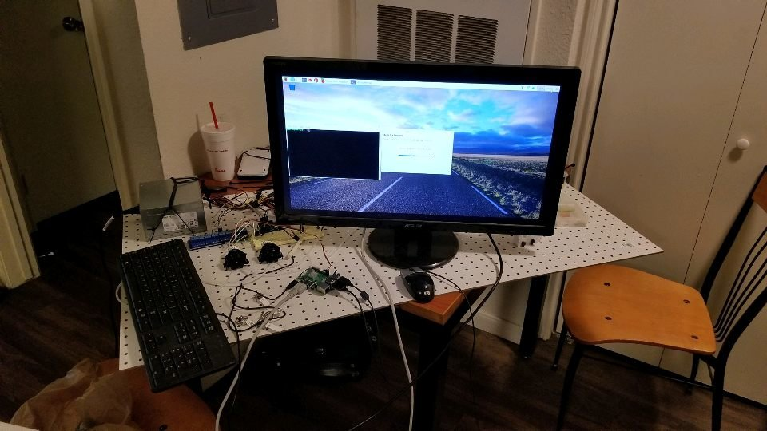
Hardware issues
An arduino was required to use the relays.
RPi outputs at 3.3v but the relays require 5v to switch states.
Arduino outputs at 5v.
The pump we used for the soda distribution would not work with carbonation.
We had many mistakes on how the devices were wired with the RPi and Arduino.

Slide 10
Software issues
Relays use the inverse of the logic signal received.
Arduino would initialize to all the relays being on.
Raspberry Pi Python GPIO functions were giving us trouble until the device had been updated.

Slide 11
Changes from initial design
Change the method of pumping the soda from a direct pump to a forced air injection pump.
Changes to how the pump control wiring is hooked up to the RPi.
Changes to the power distribution system.

